Slide 1
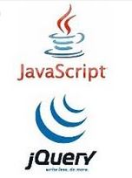
JavaScript and jQuery Course
Session 07 Arrays

Slide 2
Arrays
special type of variables / object
stores multiple values using a single variable name
for a list or collection

Slide 3
Arrays
Array() object - uppercase A
arrays always begin with 0 (zero) index
each element in the array has an index value
an array has a length property

Slide 4
Create an Array – Alternative 1
var myArray = new Array();
myArray[0] = "apples";
myArray[1] = "oranges";
myArray[2] = "pears";
myArray[3] = "peaches";
instance of object
JS keyword / operator
JS object
index number - BRACKETS

Slide 5
Create an Array – Alternative 2
var myArray = new Array("apples", "oranges", "pears");
JS keyword / operator
Define contents of array when declaring the variable

Slide 6
Create an Array – Alternative 3
var myArray = ["apples", "oranges", "pears"];
new operator not used
JS knows it is an array by the [ ]

Slide 7
Create an Array – Alternative 4
var myArray = [ ];
myArray[0] = "apples";
myArray[1] = "oranges";
myArray[2] = "pears";
Declare the array
then define contents later

Slide 8
My Choice
var myArray = new Array();
myArray[0] = "apples";
myArray[1] = "oranges";
myArray[2] = "pears";
myArray[3] = "peaches";

Slide 9

Retrieve element from an array – need to use brackets
var myArray = new Array();
myArray[0] = "apples";
myArray[1] = "oranges";
myArray[2] = "pears";
myArray[3] = "peaches";
alert("myArray[0] is " + myArray[0]);

Slide 10

Retrieve all elements from an array
var myArray = new Array();
myArray[0] = "apples";
myArray[1] = "oranges";
myArray[2] = "pears";
myArray[3] = "peaches";
alert("myArray is " + myArray);

Slide 11
length property of an Array
var myArray = new Array();
myArray[0] = "apples";
myArray[1] = "oranges";
myArray[2] = "pears";
myArray[3] = "peaches";
alert("myArray.length is " + myArray.length);

Slide 12

Loop through an array
var myArray = new Array();
myArray[0] = "apples";
myArray[1] = "oranges";
myArray[2] = "pears";
myArray[3] = "peaches";
for (var i = 0; i < myArray.length; i++)
{
alert("myArray[i] is " +
myArray[i] +
"and i is " + i);
}

Slide 13
Modify an array
var myArray = new Array();
myArray[0] = "apples";
myArray[1] = "oranges";
myArray[2] = "pears";
myArray[3] = "peaches";
myArray[3] = "ripe peaches";
new value for element

Slide 14
Add an element to an array
var myArray = new Array();
myArray[0] = "apples";
myArray[1] = "oranges";
myArray[2] = "pears";
myArray[3] = "peaches";
myArray[myArray.length] = "bananas";
last element = [4]

Slide 15
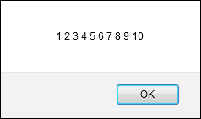
Create empty array – add elements
var numbers = [];
for (var i = 0; i < 10; i++) {
numbers[i] = i + 1;
}
Code that displays the numbers array created above
var numbersString = "";
for (var i = 0; i < numbers.length; i++) {
numbersString += numbers[i] + " ";
}
alert (numbersString);

Slide 16
Loop through an array – using for loop
var myArray = new Array();
myArray[0] = "apples";
myArray[1] = "oranges";
myArray[2] = "pears";
myArray[3] = "peaches";
for (var i = 0; i < myArray.length; i++)
{
alert("myArray[i] is " +
myArray[i] +
"and i is " + i);
}

Slide 17
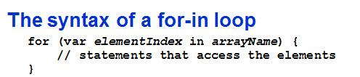
Loop through an array – using for-in loop
var myArray = new Array();
myArray[0] = "apples";
myArray[1] = "oranges";
myArray[2] = "pears";
myArray[3] = "peaches";
for (var i in myArray)
{
alert("myArray[i] is " +
myArray[i] +
"and i is " + i);
}

Slide 18

Loop through an array – using for loop and innerHTML
var myArray = new Array();
myArray[0] = "apples";
myArray[1] = "oranges";
myArray[2] = "pears";
myArray[3] = "peaches";
window.onload = function(){
for (var i = 0; i < myArray.length; i++) { document.getElementById("array").innerHTML += myArray[i] + "<br>";
}
} // end onload
<body><p id="array"> </p></body>

Slide 19
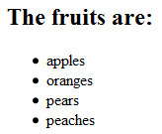
Loop through an array – using for loop and innerHTML
var myArray = new Array();
myArray[0] = "apples";
myArray[1] = "oranges";
myArray[2] = "pears";
myArray[3] = "peaches";
window.onload = function(){
var str = "<h2>The fruits are:</h2>";
var str2 = " ";
for (var i = 0; i < myArray.length; i++)
{
str2 += "<li>" + myArray[i] + "</li>";
}
document.getElementById("array").innerHTML = str + "<ul>" + str2 + "</ul>";
} // end onload
<body><p id="array"> </p></body>

Slide 20
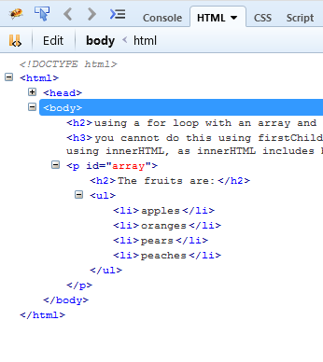
Loop through an array – test using browser dev tools

Slide 21
Manipulate an Array
join() | Joins elements into a string
concat() | Merges arrays
indexOf() | Searches for an element
pop() | Removes last element
push() | Add an element to the end
shift() | Removes first element
unshift() | Add an element to the beginning

Slide 22
DATES - Methods of Date() Object
var today = new Date(); | Define/initialize variable named today
var dayNum = today.getDate(); | Returns day of month, from 1 to 31
var dayWeek = today.getDay(); | Returns day-of-week, from 0 to 6 Sunday=0, Monday=1, ... Saturday=6
var monthNum = today.getMonth(); | Returns month number, from 0 to 11 January=0, February=2, ... December=11
var year = today.getFullYear(); | Returns the 4-digit year Use this instead of getYear()

Slide 23
Return day of the week using an Array
var today = new Date();
var theDay = today.getDay(); //returns a number from 0-6
//use that number as the array index to get its value
var days = new Array();
days[0] = "Sunday";
days[1] = "Monday";
days[2] = "Tuesday";
days[3] = "Wednesday";
days[4] = "Thursday";
days[5] = "Friday";
days[6] = "Saturday";
alert("The day is " + days[theDay] );

Slide 24
Return day of the week using if..else if
var today = new Date();
var theDay = today.getDay(); //returns a number from 0-6
var day;
if (theDay == 0) { day = "Sunday"; }
else if(theDay == 1) { day = "Monday"; }
else if(theDay == 2) { day = "Tuesday"; }
else if(theDay == 3) { day = "Wednesday"; }
else if(theDay == 4) { day = "Thursday"; }
else if(theDay == 5) { day = "Friday"; }
else if(theDay == 6) { day = "Saturday"; }
alert("The day is " + day );

